Slide 1
Concept:
The idea was create a medieval-themed tactical role-playing game. The game would feature fantasy elements of magic and monsters. The game would initially be developed for the PC.

Slide 2
Sprint 6 - Update()
Michael: Finished mapping out placement of HUD assets.
Gabe: Worked on some of the combat logic
Dane: Moved unit models around the game board hexly – each piece moves from the center of one hexagon to the center of another.
Billy: Became a Blender Magician

Slide 3
Sprint 6 - Update()
Billy: Resolved a number of issues with Blender animations rendering properly for the introduction. Introduction for the game has been completed.

Slide 4
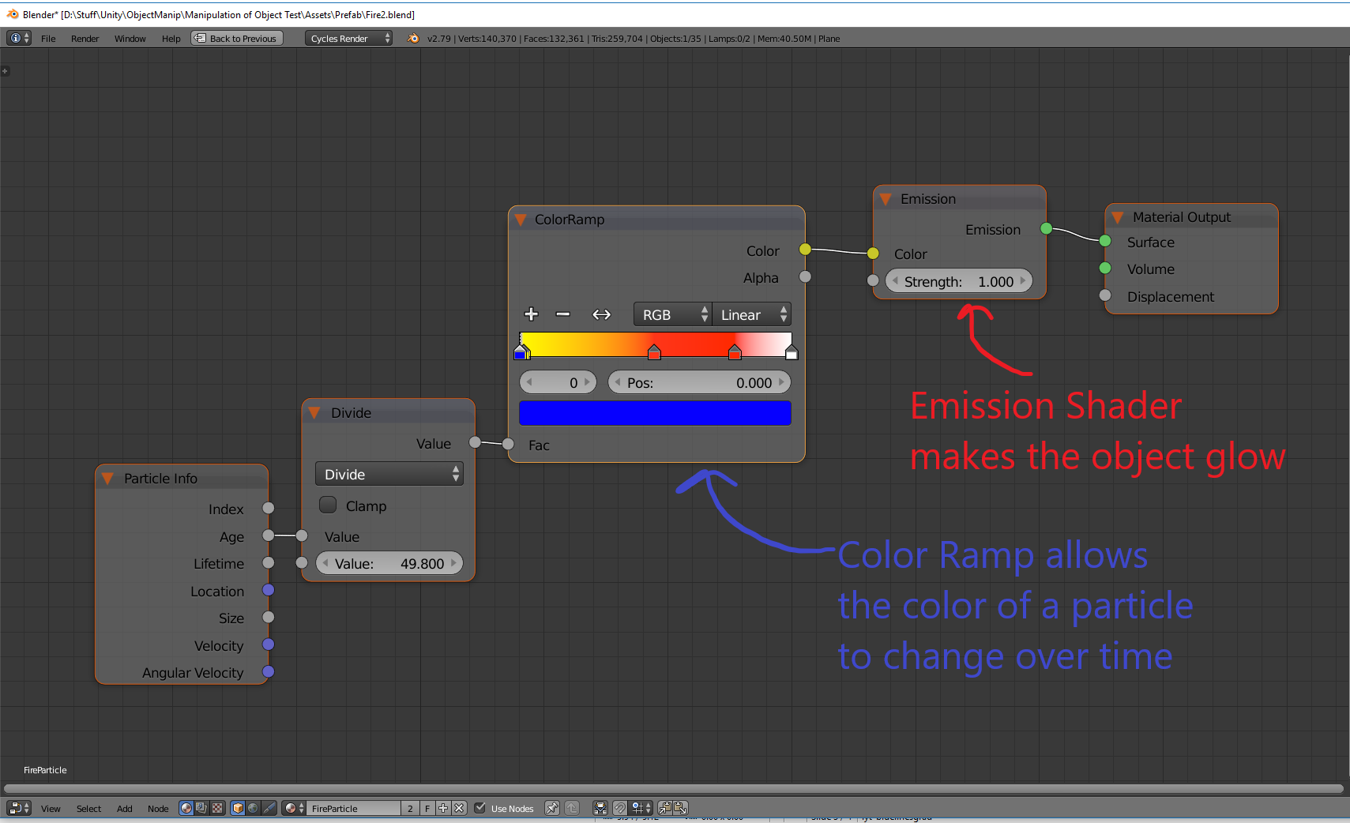
Sprint 6 - Update()

Slide 5
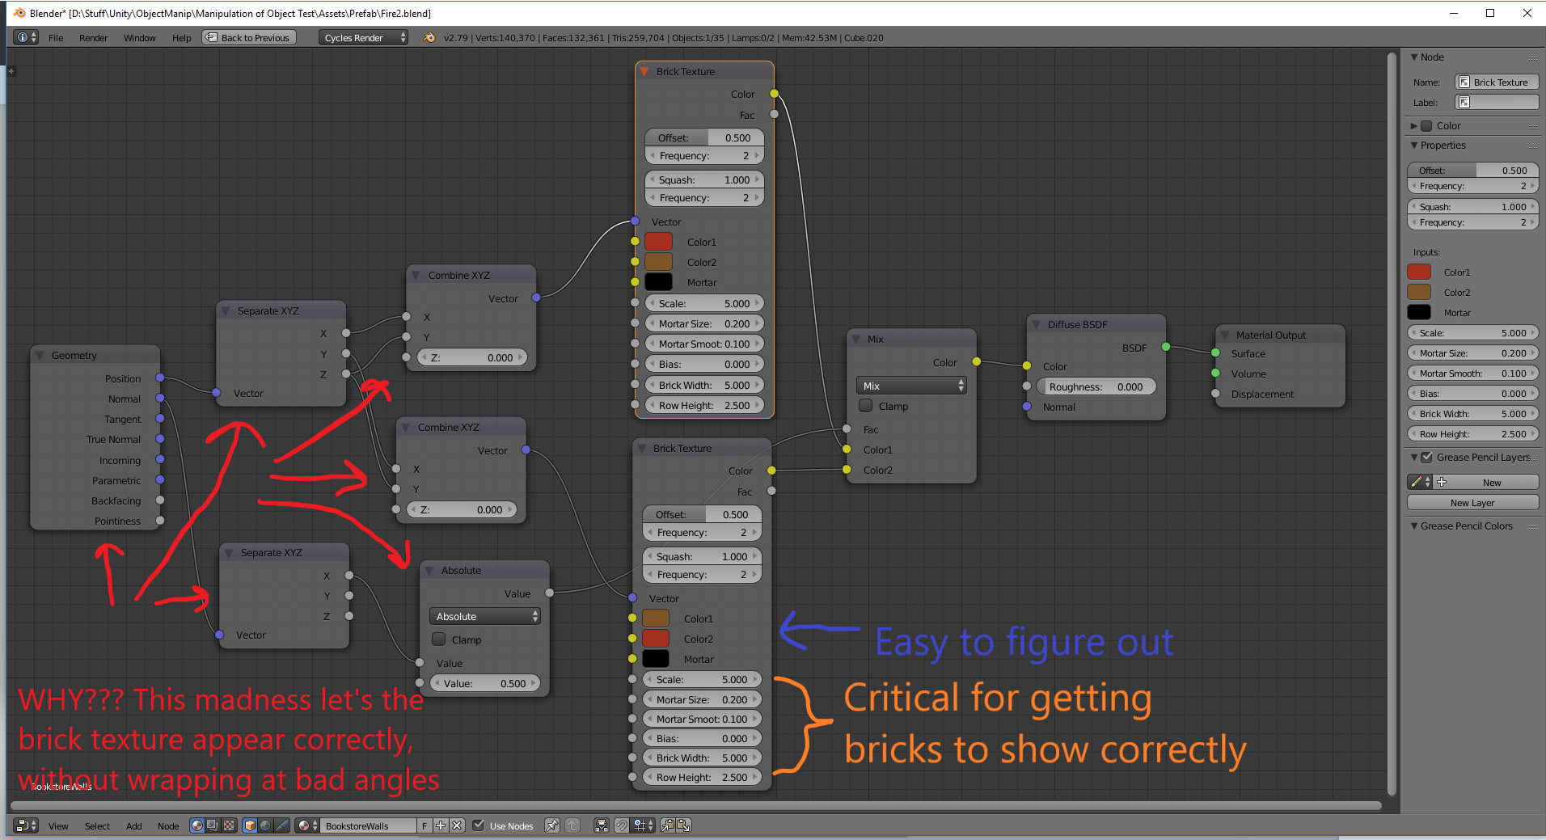
Sprint 6 - Update()

Slide 6
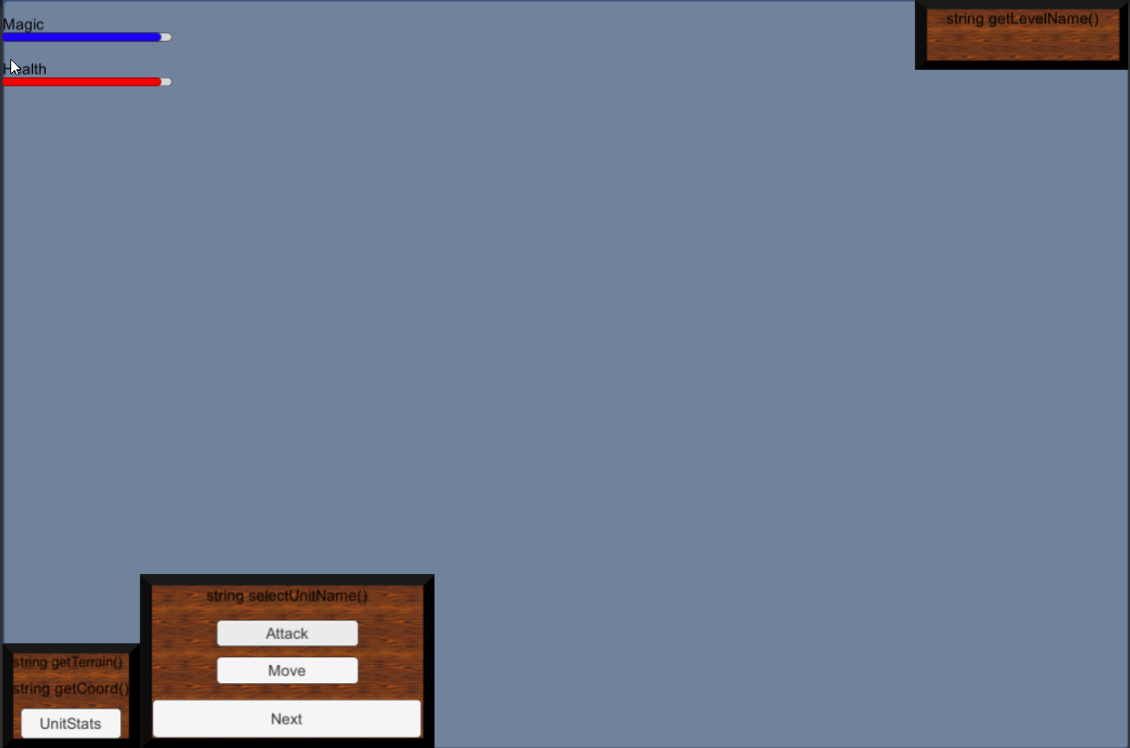
Sprint 6 – Update()

Slide 7
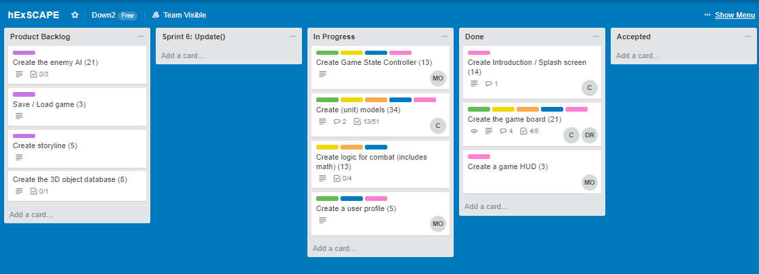
Sprint 6 - Update()

